Slide 1
REACT! - Save Energy!
Through a proper use of devices, we can save electricity at home.
A good way to save energy is to invest in the right lighting.
Saving electricity will also help to protect the natural environment.

Slide 2
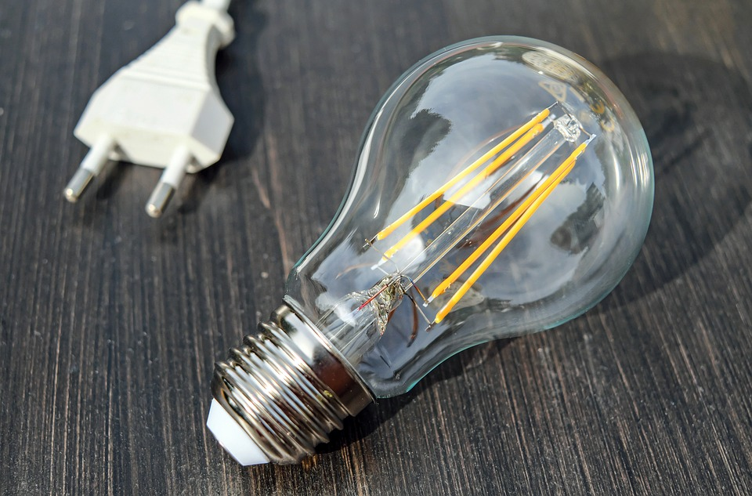
We use more and more electricity ...

Slide 3
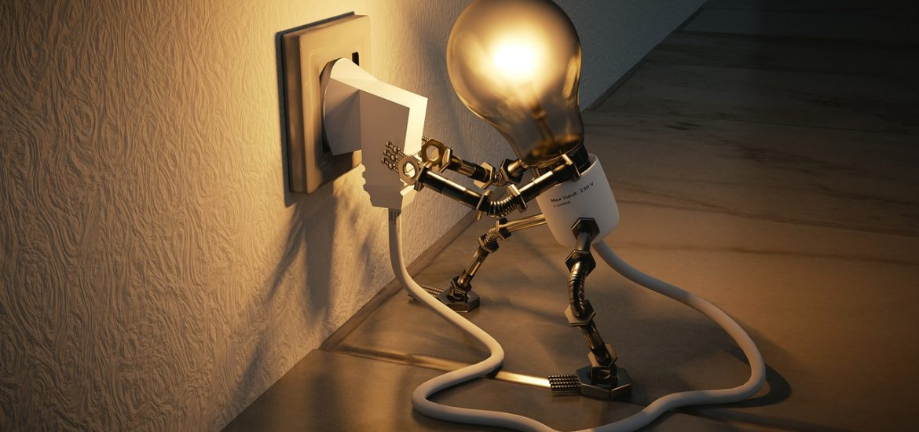
There are many ways to save energy

Slide 4
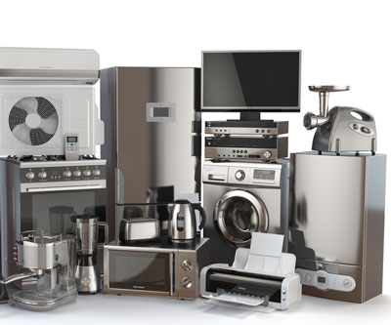
10 ways to save electricity at home - electrical appliances
When cooking, cover the pots with a lid - this will speed up the cooking process so less energy is used.
When baking in the oven, do not open it too often - the device will have to heat up again, consuming a lot of electricity.
Do not put warm food in the fridge and freezer, and make sure that the doors are closed - cooling them again takes a lot of energy.
Only use the washing machine and dishwasher when they are full - so you can turn them on less often.
If you have such an option, use the "eco" or "energy saving" mode.
Boil only as much water as you need - the more water you put into the kettle, the more energy is used.
When the device is fully charged, disconnect the charger - the charger is connected to the socket and continues to use power to the fully charged device.
Turn off devices that you are not using.
Do not leave the tap running.
Take a shower instead of a bath - this way you will use less hot water.

Slide 5
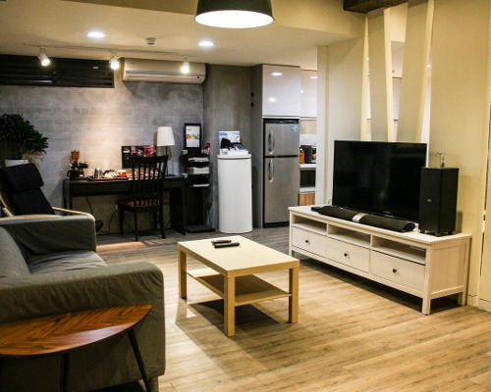
5 ways to save electricity at home - lighting
Make the most of daylight - for better light, you can move your desk or table closer to the window.
Turn off the light when you leave the room.
Buy energy-saving light bulbs - they help you save electricity. The most profitable thing will be to install them where the light stays on the longest - frequent switching on and off will make them burn out quickly.
When performing activities that do not require strong ceiling lighting, use a lamp - less intense lighting will save electricity.
If you want to illuminate the house from the outside, choose an installation with a motion sensor.

