Slide 1
REACT! - Respect Environment and Cherish Thyself - DOs and DON'Ts A guidebook to a better, sustainable and healthy lifestyle in agreement with nature and the European Climate Pact
„REACT! – Respect Environment and Cherish Thyself” (2020-1-PL01-KA229-082014)

Slide 2
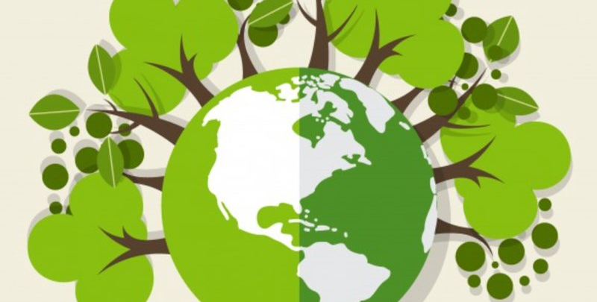
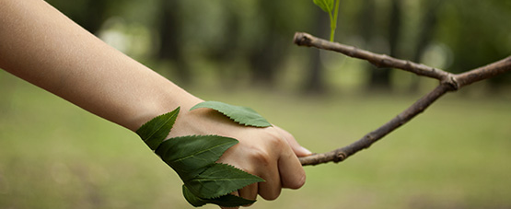
Pact The European Climate Pact is a movement of people united around a common cause, each taking steps in their own worlds to build a more sustainable Europe. Launched by the European Commission, the Pact is part of the European Green Deal and is helping the EU to meet its goal to become climate-neutral by 2050.
https://climate-pact.europa.eu/index_en

Slide 3
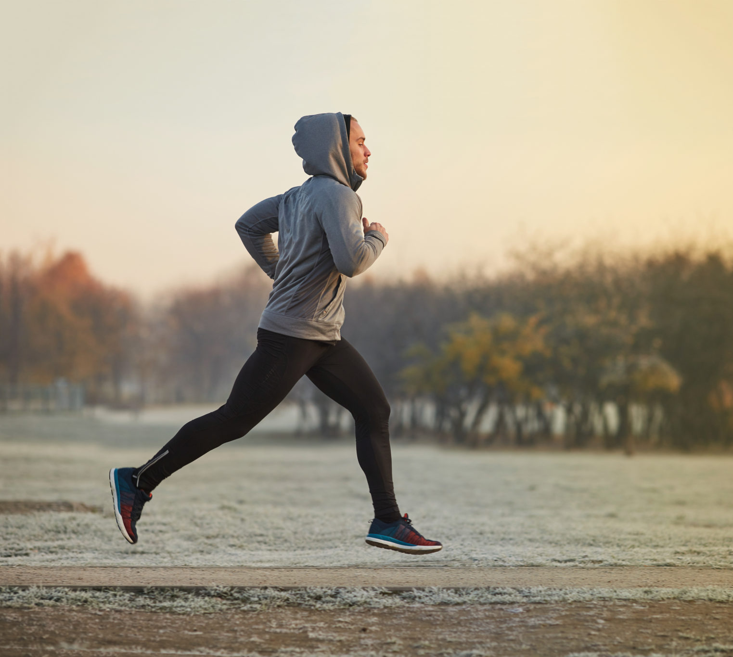
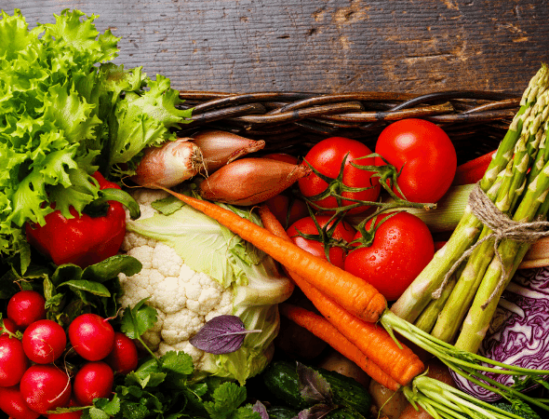
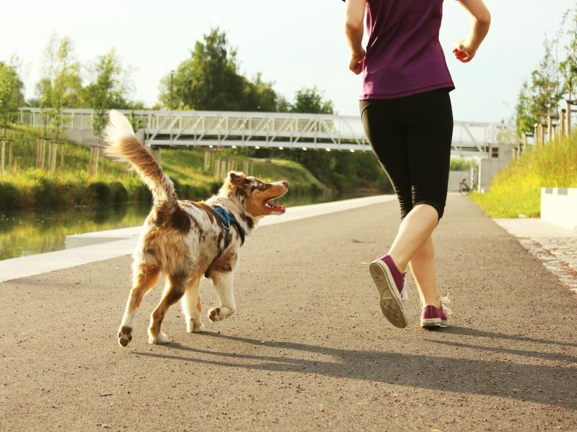
STAY HEALTHY DO:
Be active
Eating healthy
Drink a lot of water
Spend time outside, in the nature
Search the causes of diseases to know how to prevent them

Slide 4
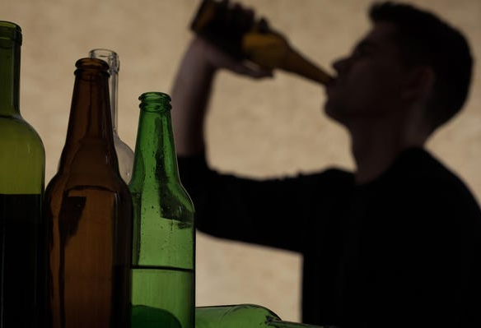
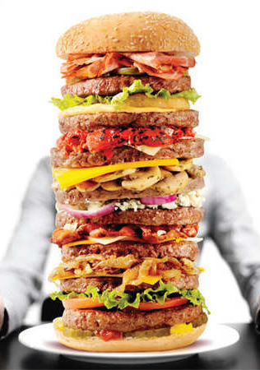
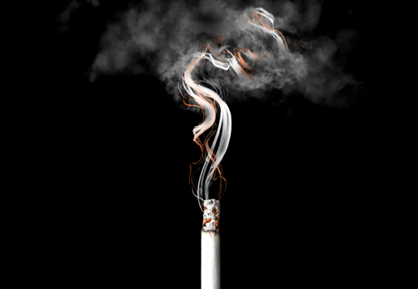
STAY HEALTHY DON'T:
Smoke
Drink alcohol
Do drugs
Have toxic relationship
Eat processed food

Slide 5
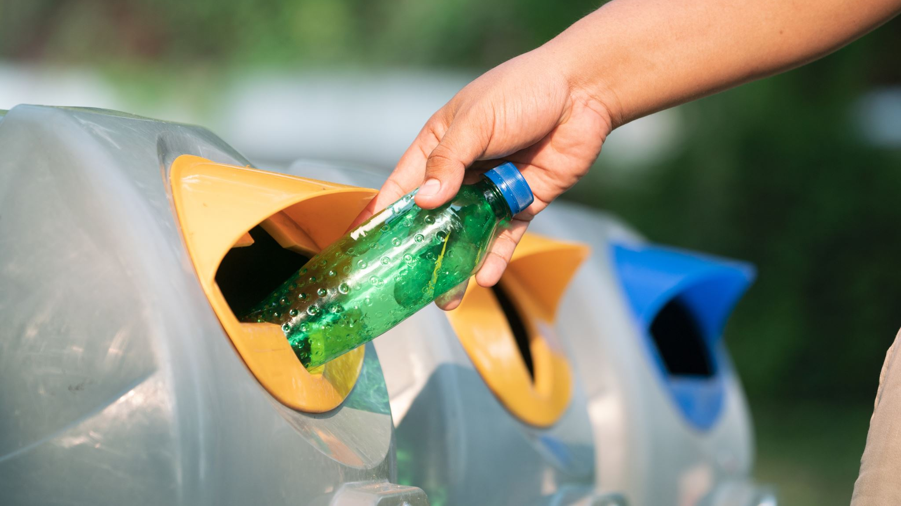
BE ECO-FRIENDLY DO:
Recycle, reuse, reduce and refuse
Use public transport
Plant a tree, at least
Buy second hand things
Save water and electricity
Discard the potential toxic materials in the rightful containers

Slide 6
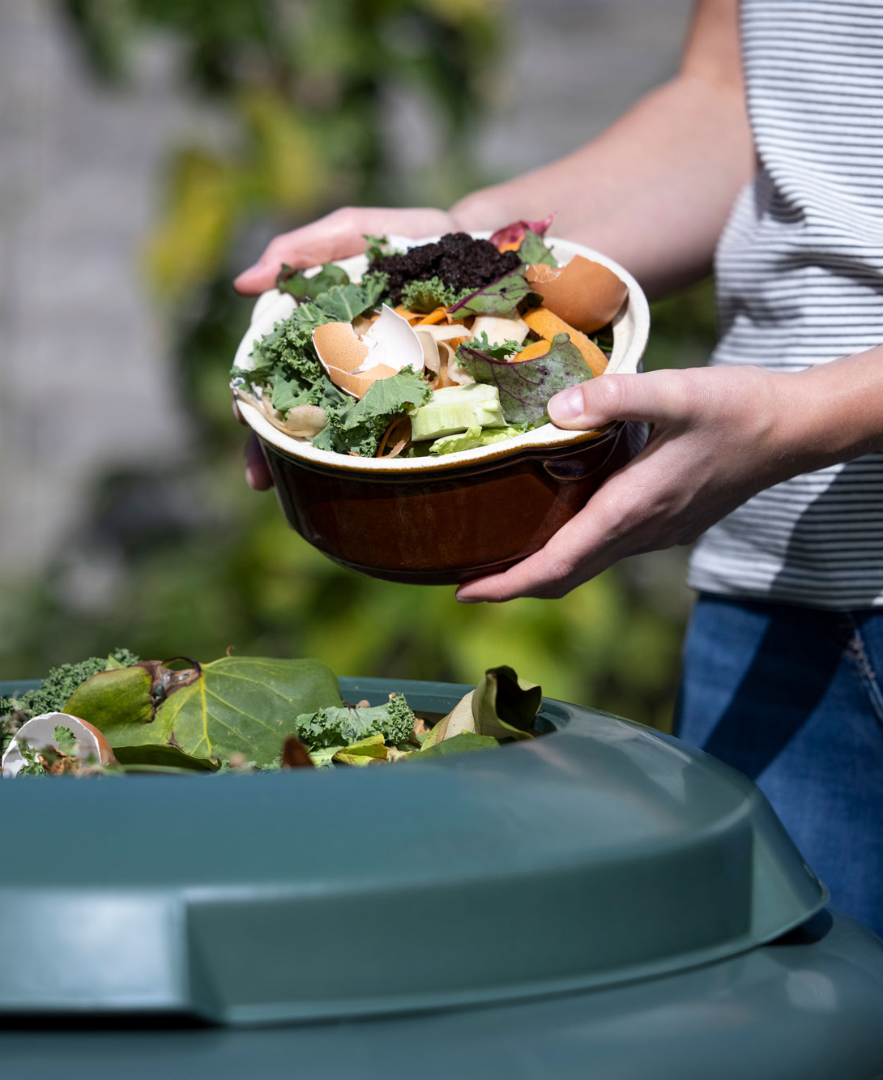
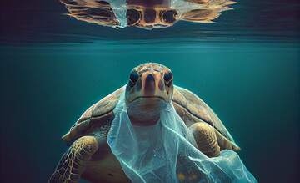
BE ECO-FRIENDLY DON'T:
Waste food
Follow the fast fashion
Use plastic bags
Eat a lot of meat
Buy products containing ozone killing chemicals

Slide 7
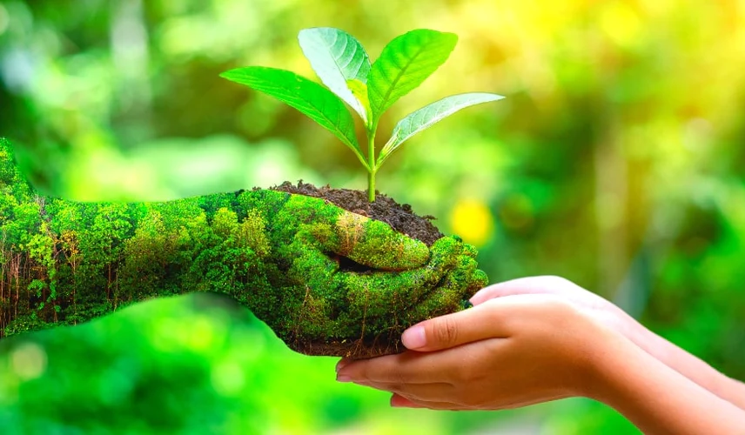
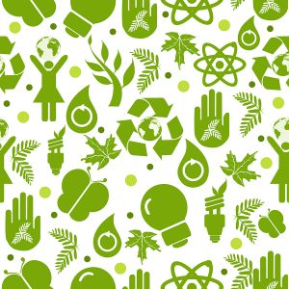
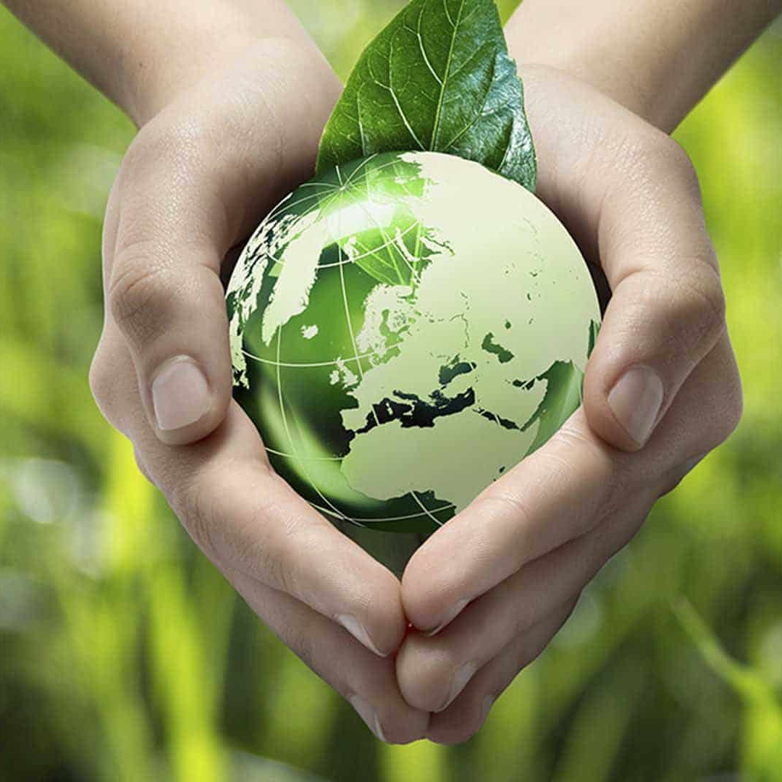
Cherish Thyself! Respect the Environment!

