Slide 1
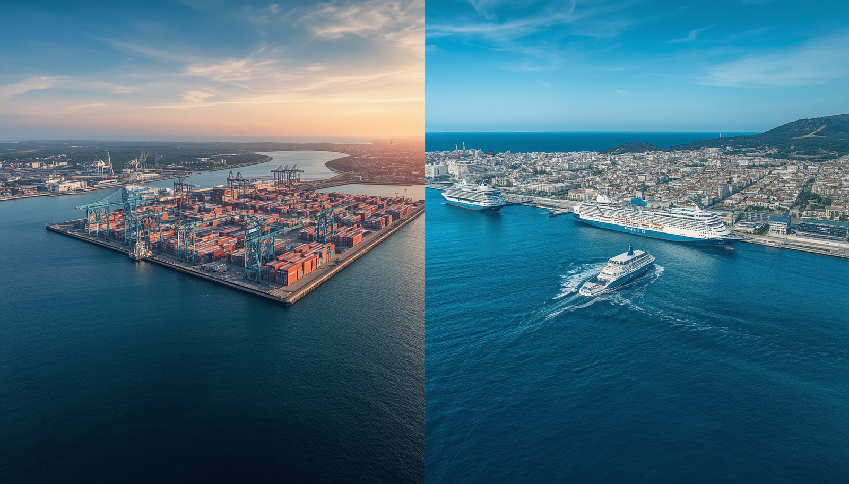


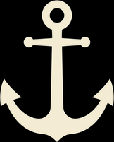
PORT CITIES
COMPARING PIRAEUS AND GDYNIA
THROUGH THE LENS OF SUSTAINABILITY
Poland 2024-1-PL01-KA121-SCH-000228869
Greece 2024-1-EL01-KA122-SCH-000223080

Slide 2
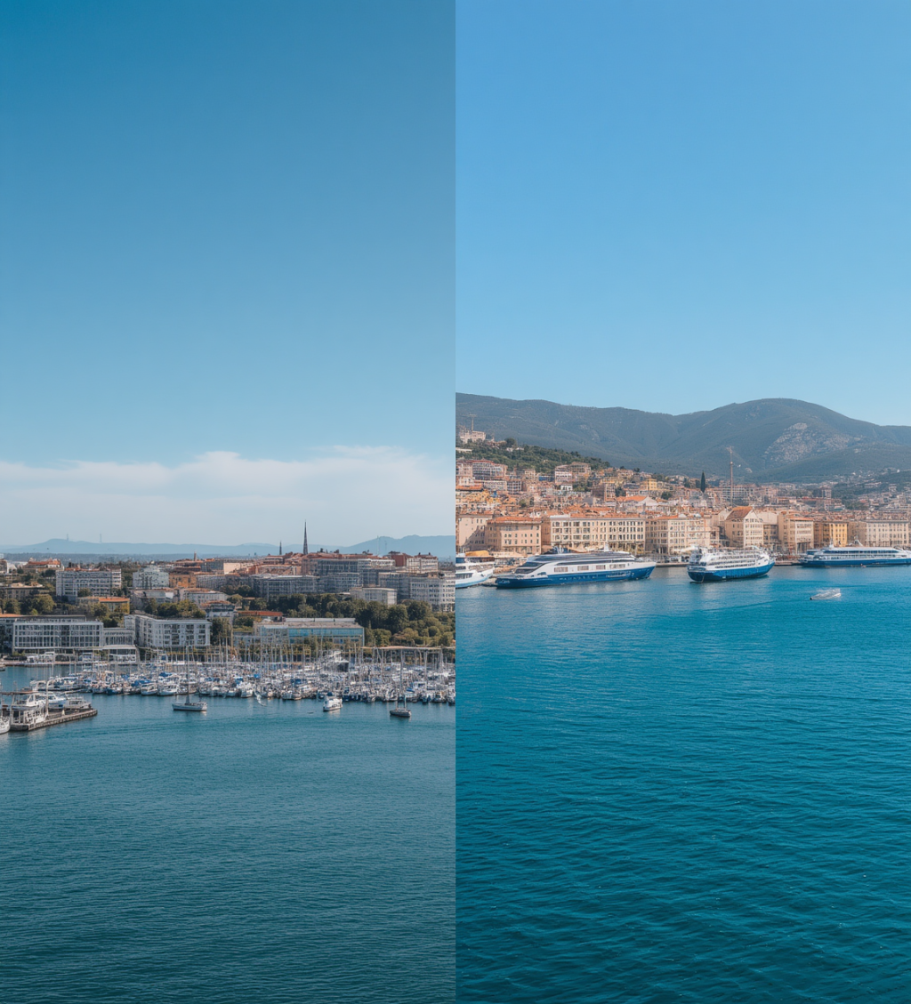



Introducing Our Cities
Gdynia and Piraeus are two dynamic European port cities located on opposite seas. Gdynia lies on the Baltic Sea in northern Poland, with a population of 240,000 and one of Poland's most important ports. Piraeus, on the Mediterranean Sea in Greece, is home to 160,000 inhabitants and serves as the largest port in Greece.
2 CITIES
TWO SEAS, ONE SHARED VISION FOR SUSTAINABILITY

Slide 3

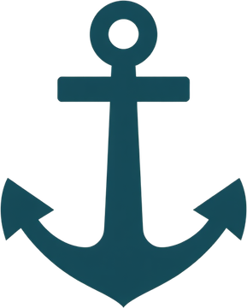




Our Project Goals
Compare Port Cities
Sustainable Development
Environmental Protection
European Student Exchange
Compare Gdynia and Piraeus as European port cities
Explore sustainable development in coastal urban areas
Learn about ecological practices and environmental care
Exchange ideas and cooperate as young Europeans

Slide 4
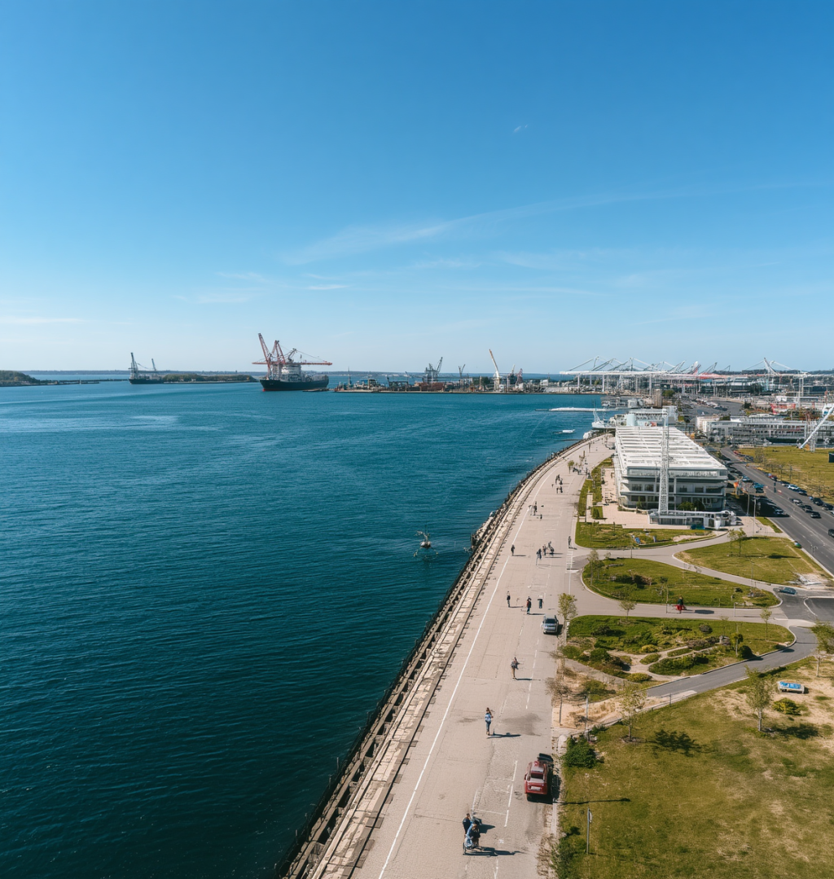

Gdynia:
A Green Port City
Sustainable public transport
Electric trolleybuses and low-emission vehicles
Cycling infrastructure
Extensive bike lanes across the city
Coastal protection
Baltic Sea shoreline conservation efforts
Environmental education
Raising awareness in local communities

Slide 5
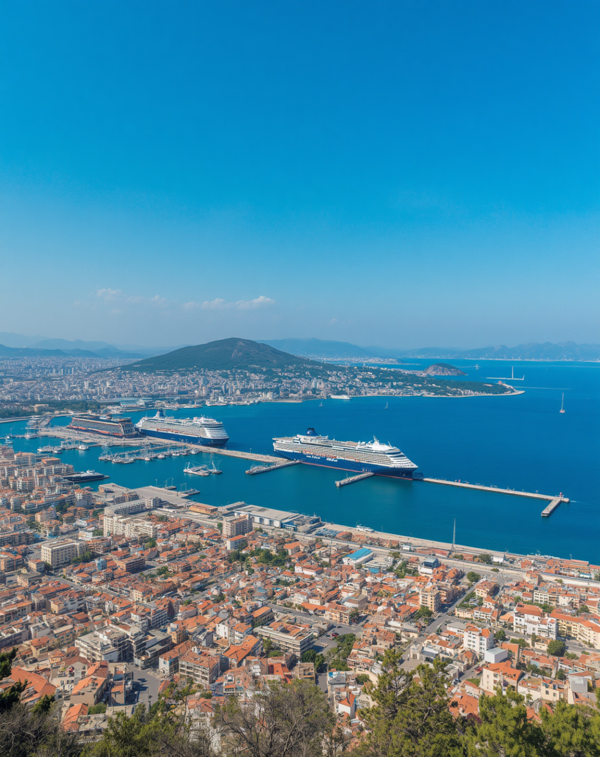

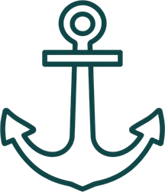
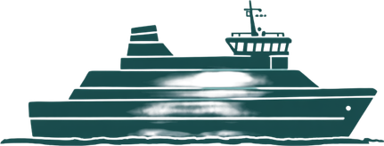


Piraeus: A Mediterranean Gateway
Largest Greek Port
Ferry Transportation
Metro Connections
Sustainable Urban Projects
Major hub for international shipping and commerce in the Eastern Mediterranean
Connecting mainland Greece to hundreds of islands across the Aegean Sea
Integrated metro and rail links reducing urban congestion and emissions
Port modernization with green infrastructure and waterfront regeneration

Slide 6

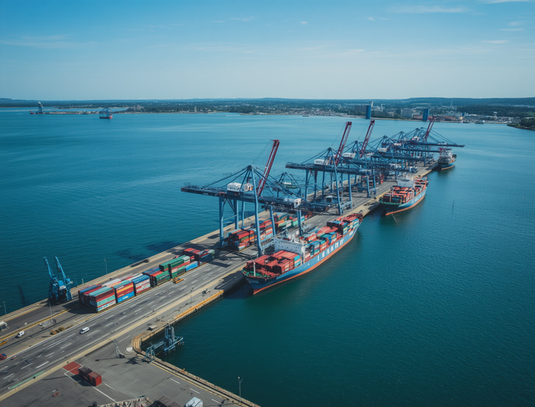
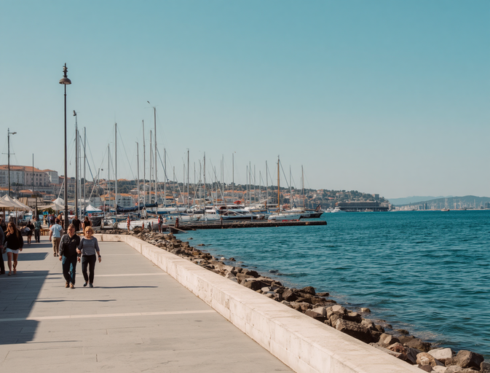
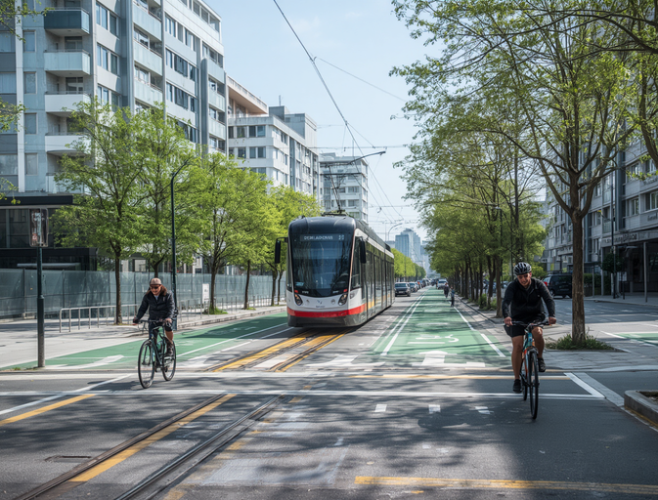



What Do the Cities Have in Common?
Major Ports & International Trade
Tourism & Environmental Challenges
Sustainable Development & Public Transport
Both Gdynia and Piraeus are key European maritime hubs driving global commerce
Coastal tourism growth brings shared ecological pressures to both port cities
Green mobility plans and eco-urban projects unite both cities' future visions

Slide 7
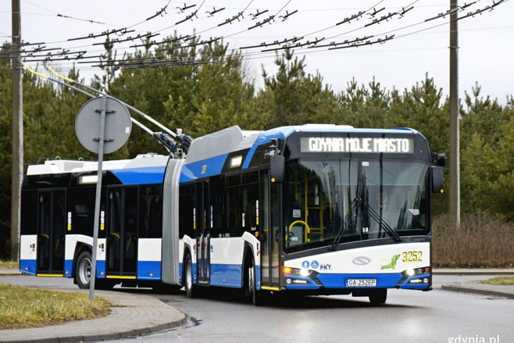
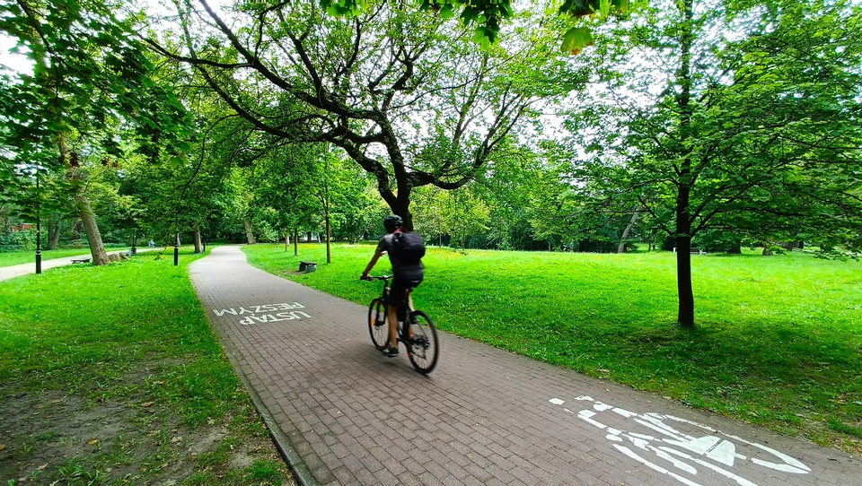
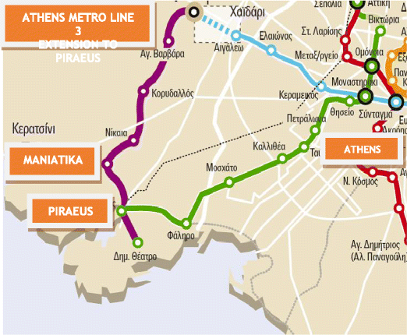
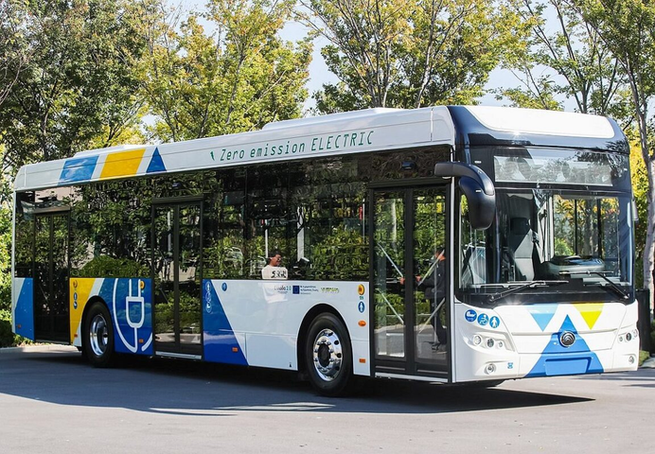
Sustainable Mobility
Gdynia: Electric trolleybuses & buses
Gdynia: Green mobility & low-emission transport
Piraeus: Metro system & public transport
Piraeus: Sustainable urban transport

Slide 8

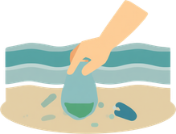


Protecting the Sea and the Environment
Marine Pollution Reduction
Beach Cleaning
Biodiversity Protection
Green Urban Spaces

Slide 9
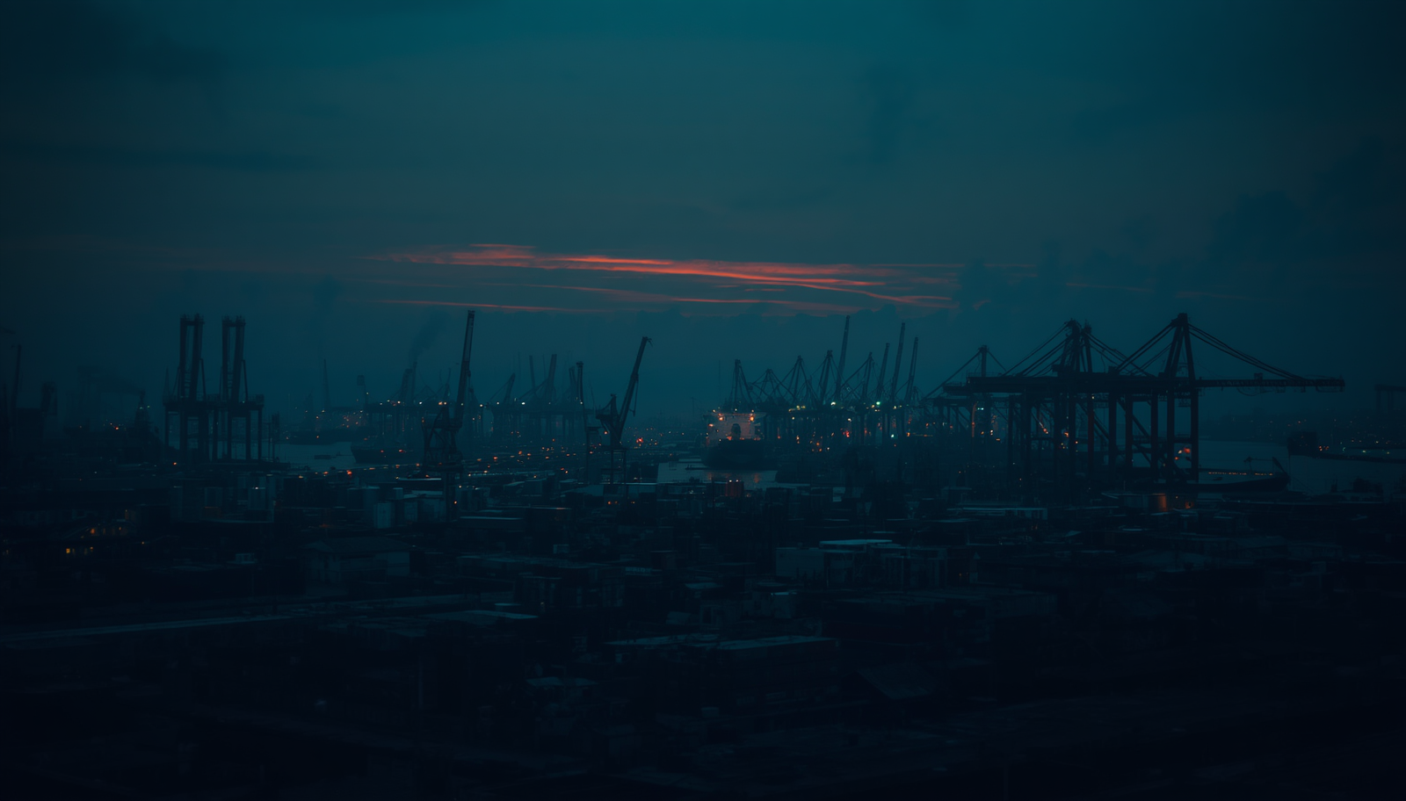


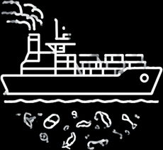
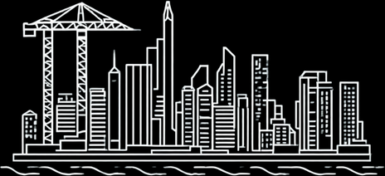
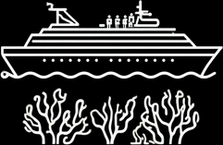


Environmental Challenges
Air pollution & climate change
Shipping emissions & marine litter
Urbanization pressure on coasts
Tourism impact on ecosystems

Slide 10
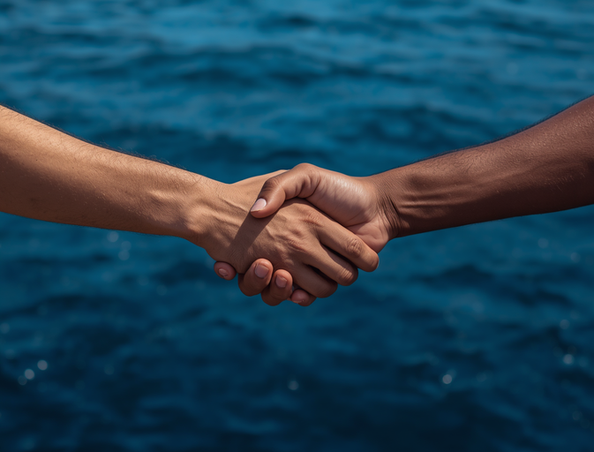

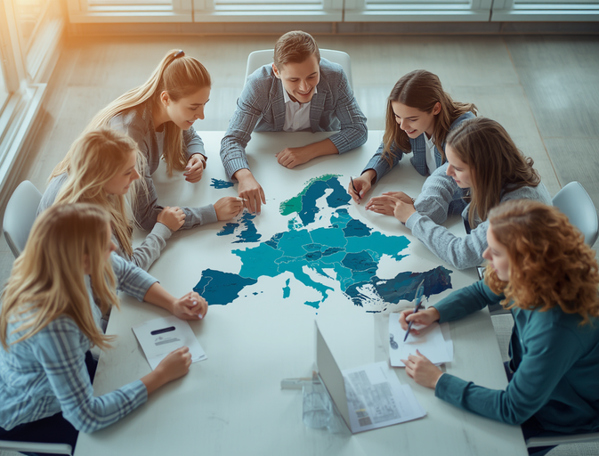



Our Conclusions
Sustainability Requires Cooperation
Education Matters for Change
European Cooperation Works
Cities and nations must work together to achieve meaningful environmental progress
Young people equipped with knowledge can drive sustainable innovation and action
Erasmus+ partnerships show how shared ideas help solve global environmental problems

Slide 11
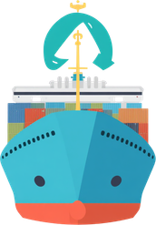



Our Ideas for the Future
More Green Spaces & Renewable Energy
Cleaner Ports & Sustainable Transport
Protection of Marine Ecosystems
International Cooperation

Slide 12
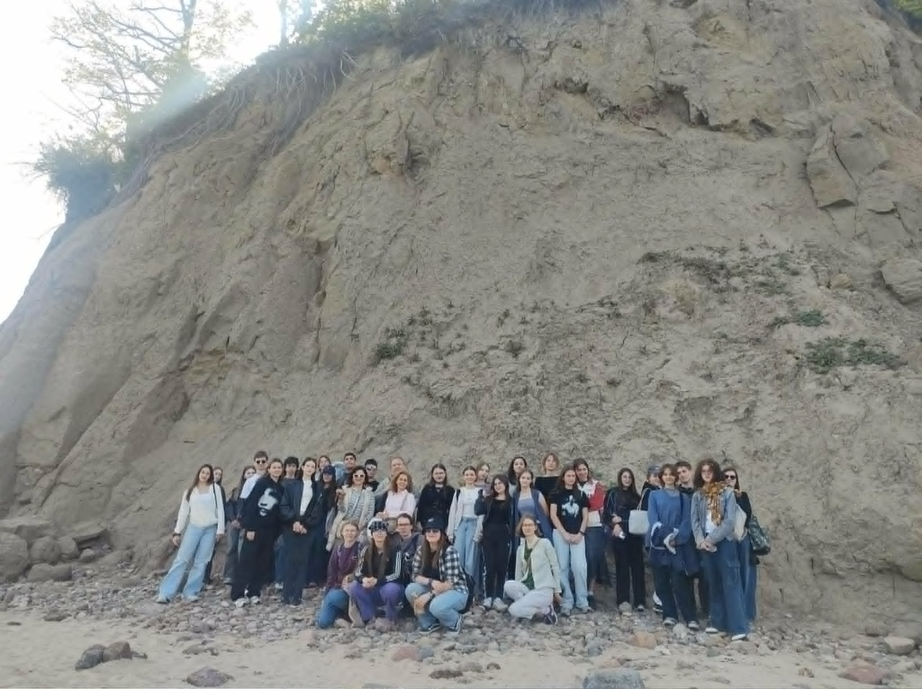
Working Together for
A Sustainable Future
🇵🇱 Poland – 🇬🇷 Greece
Comparing Piraeus and Gdynia Through the Lens of Sustainability
Erasmus+ | Together for a greener, sustainable Europe.

