Slide 1
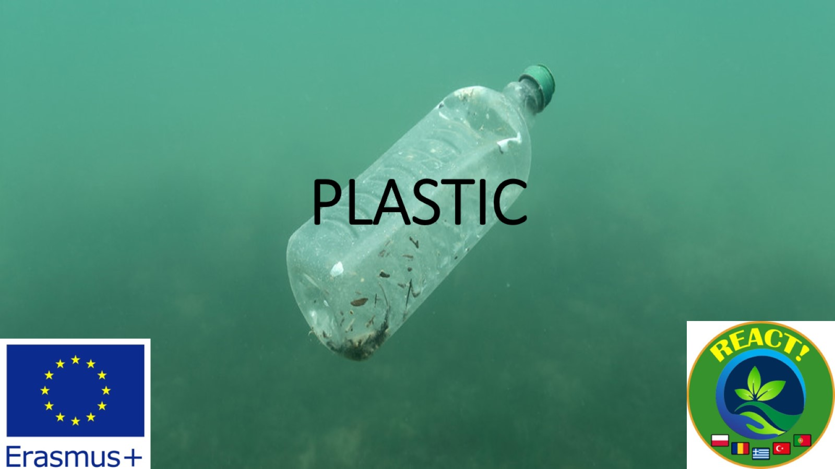
PLASTIC

Slide 2
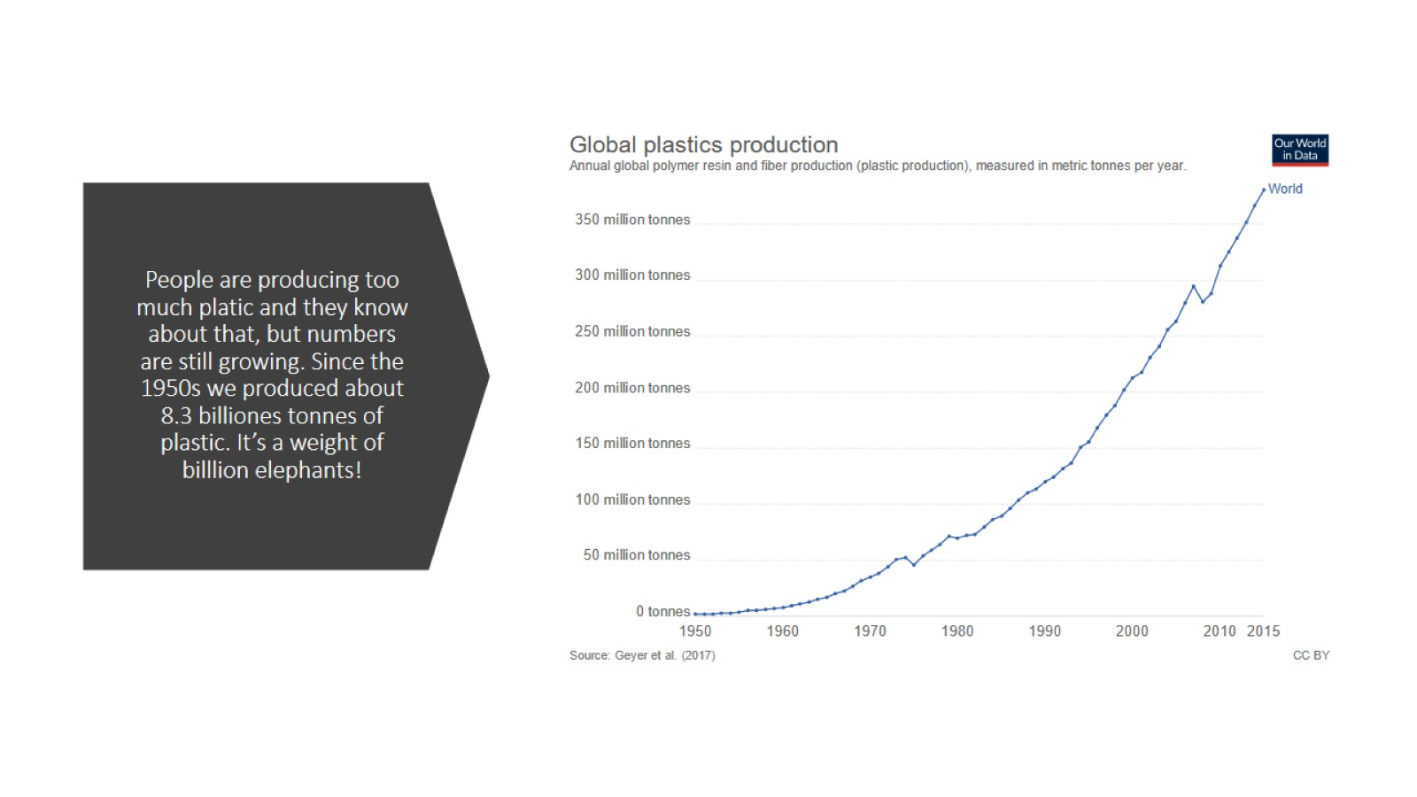
People are producing too much platic and they know about that, but numbers are still growing. Since the 1950s we produced about 8.3 billiones tonnes of plastic. It’s a weight of billlion elephants!

Slide 3
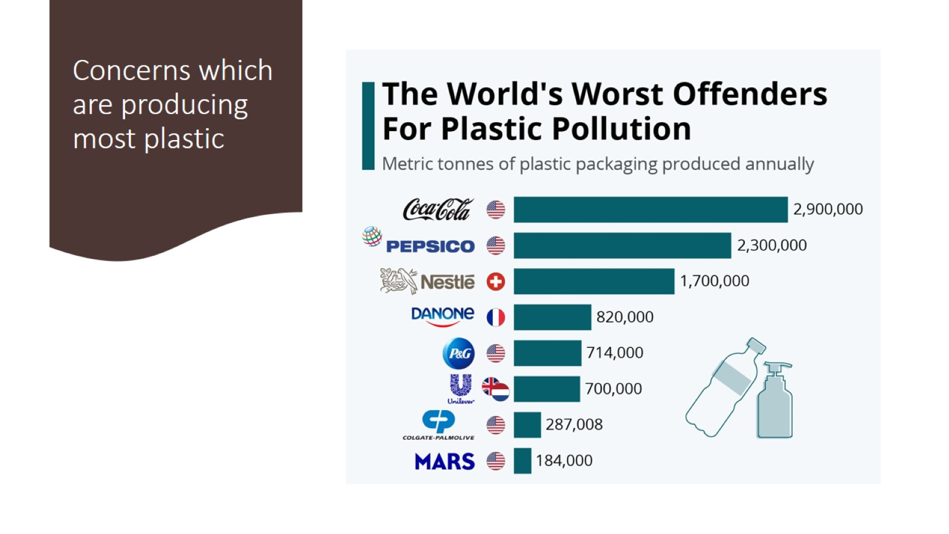
Concerns which are producing most plastic

Slide 4
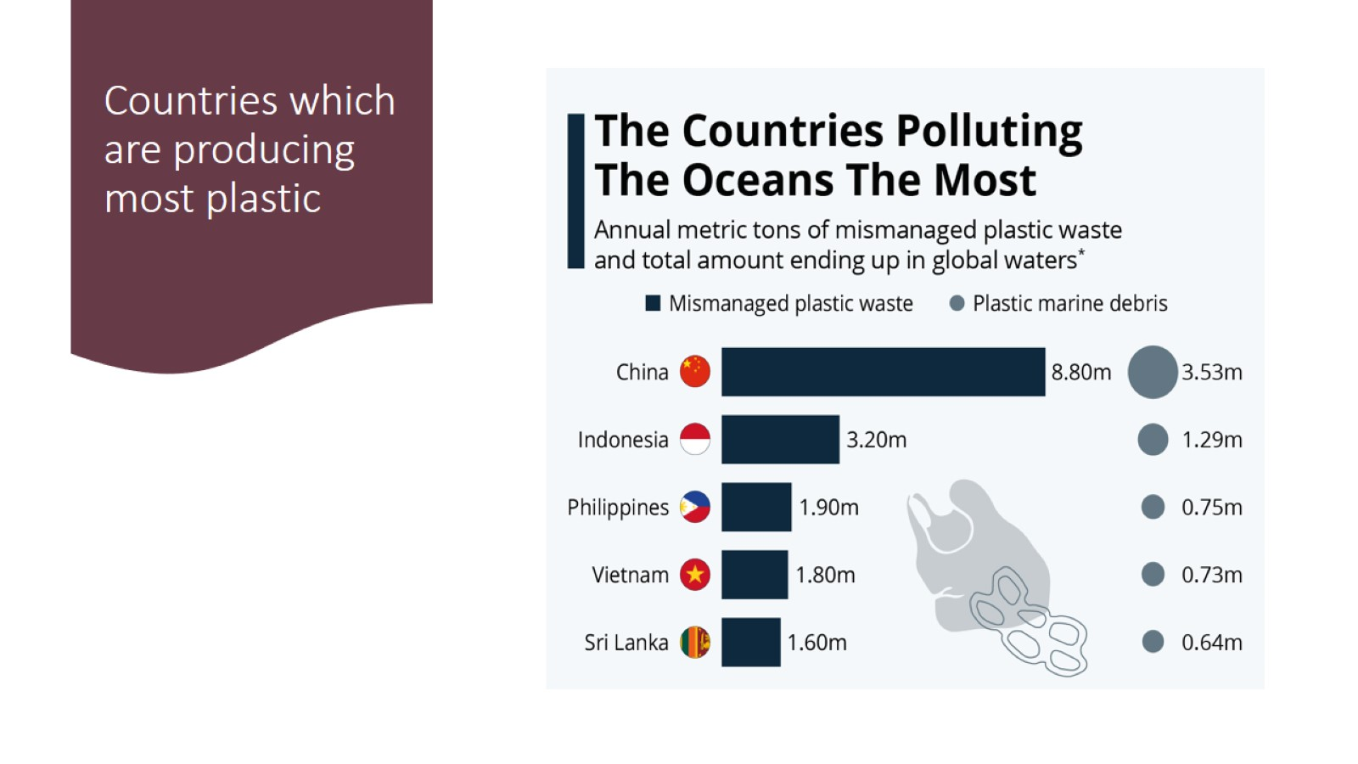
Countries which are producing most plastic

Slide 5
What’s wrong with plastic?

Slide 6
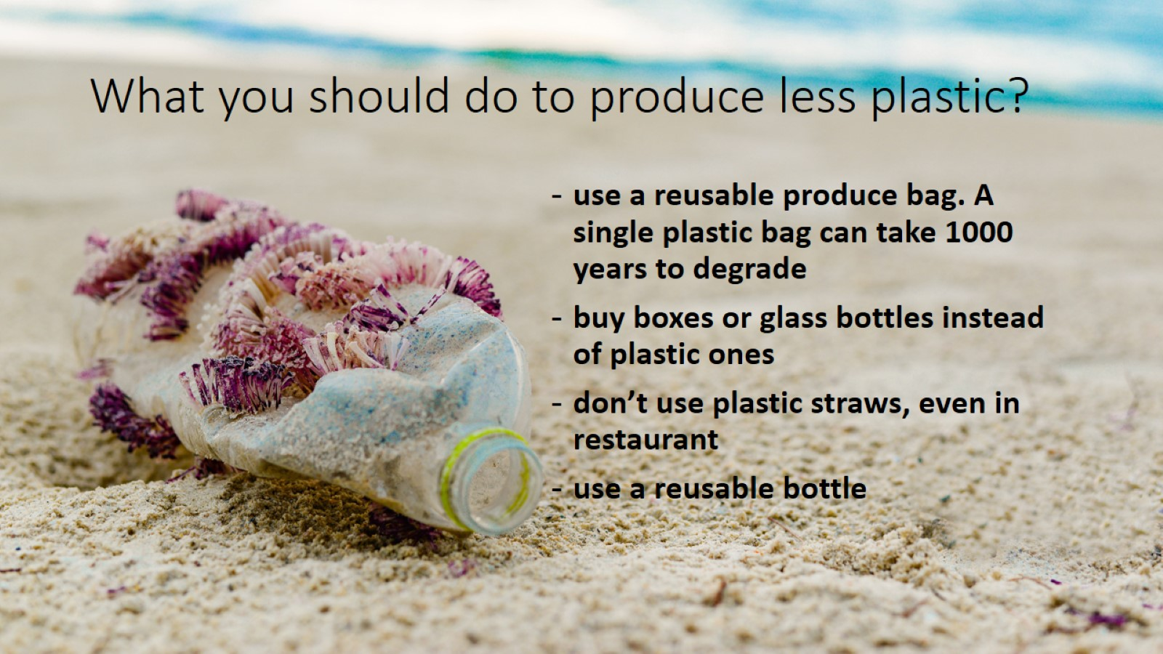
What you should do to produce less plastic?

Slide 7
Thank you for atention!

