Slide 1
How can we save energy at home?
wejdź na

Slide 2
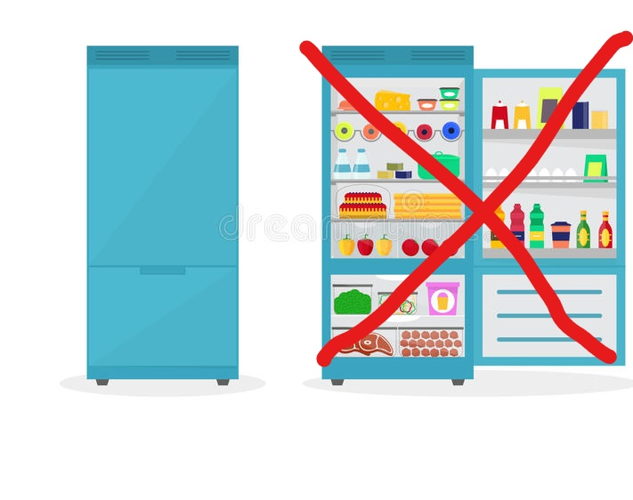
Do not open the refrigerator door frequently
When you open your refrigerator, the cold air that keeps your food fresh escapes and is replaced by warm air from the room.

Slide 3
Use natural light
BENEFITS
you save power
you can avoid eye problems
daylighting promotes vitamin D generation
enhance mental performance and improved sleep

Slide 4
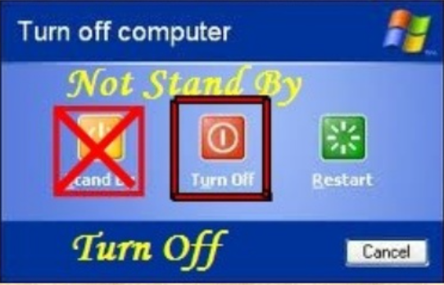
Do not leave electrical appliances work in sleep mode.

Slide 5
Do not leave the room with the lights turn on

Slide 6
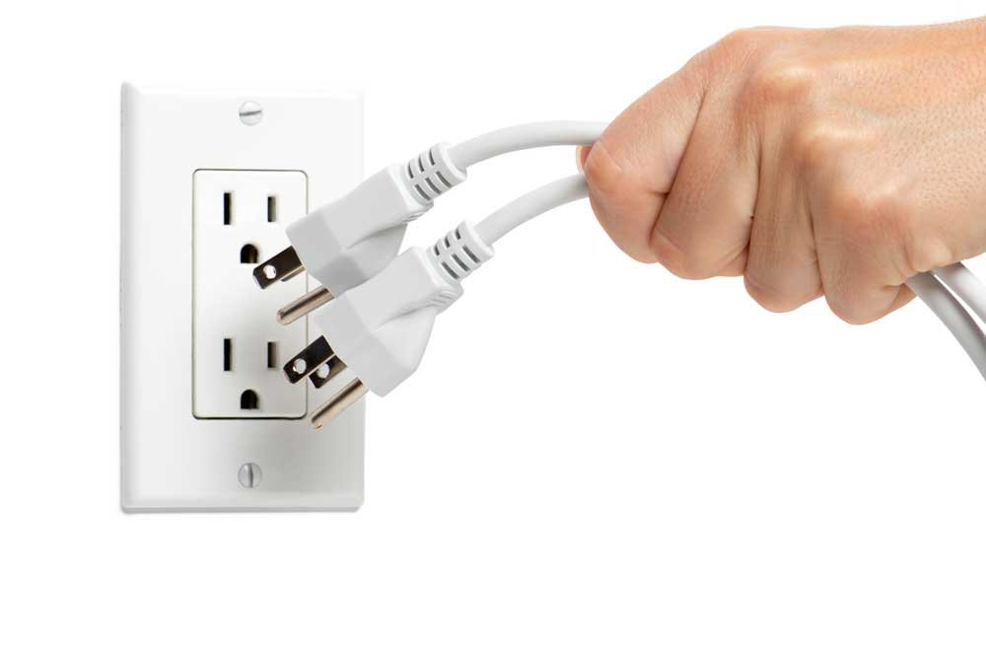
Unplug unused electronics
Standby power can account for 10% of an average household's annual electricity use

Slide 7
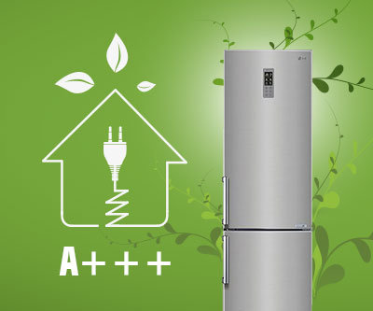
Change your AGD and bulbs for energy saving ones

Slide 8
Why we should save energy?
natural resources will be depleted
energy prices are rising
it accelerates global warming
we pollute the environment

Slide 9
THANKS FOR YOUR ATTENTION
Zosia Cybulska, Zuzia Wruk 2e

